Slide 1
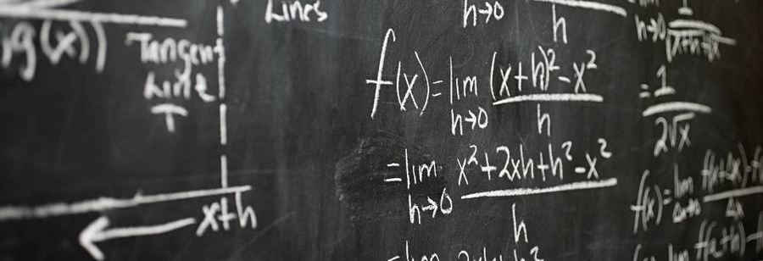
Knowledge Check
l

Slide 2
Contents of presentation
1.Our Team
2.Our Idea
3.Apps we used
Shows our team members, our roles and class
We will explain the idea of our project
Shows the apps we used to create the project
4.Summary
A quick recap of what our entire project is about

Slide 3

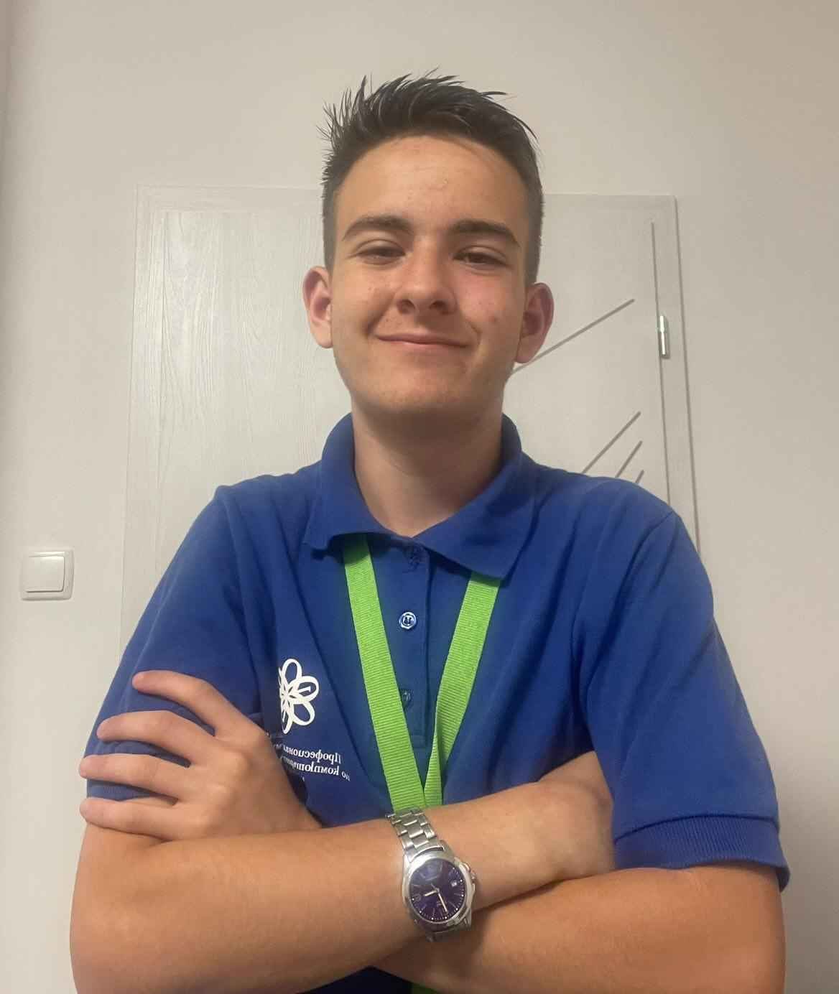
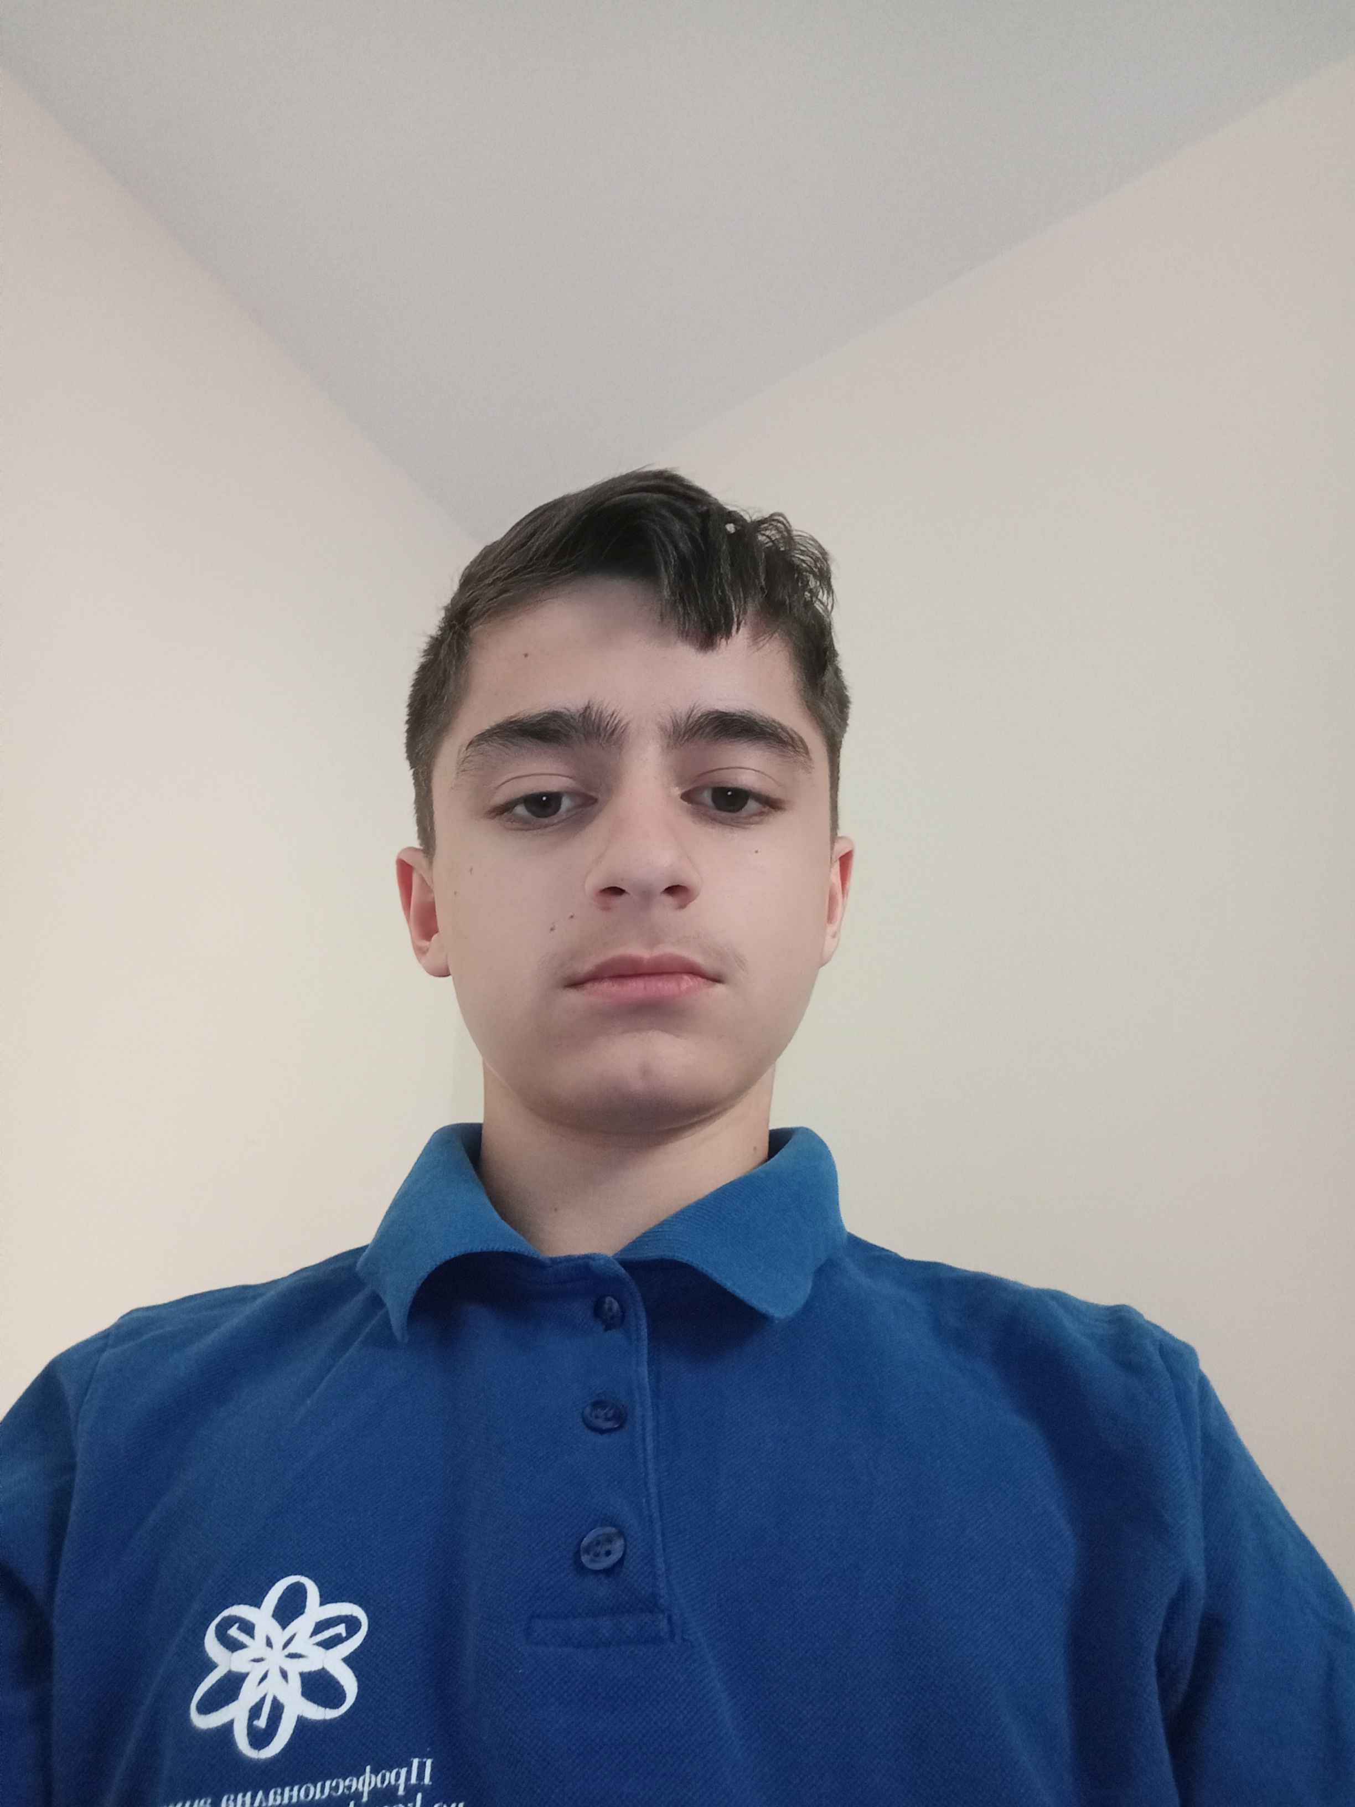
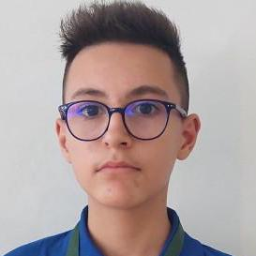
Team
Asen Kokalarov Scrum trainer -9G
Stoyan Vasilev Back-end developer -9V
Stoyan Tomov Designer - 9V
Georgi Yankov Front-end developer – 9G

Slide 4
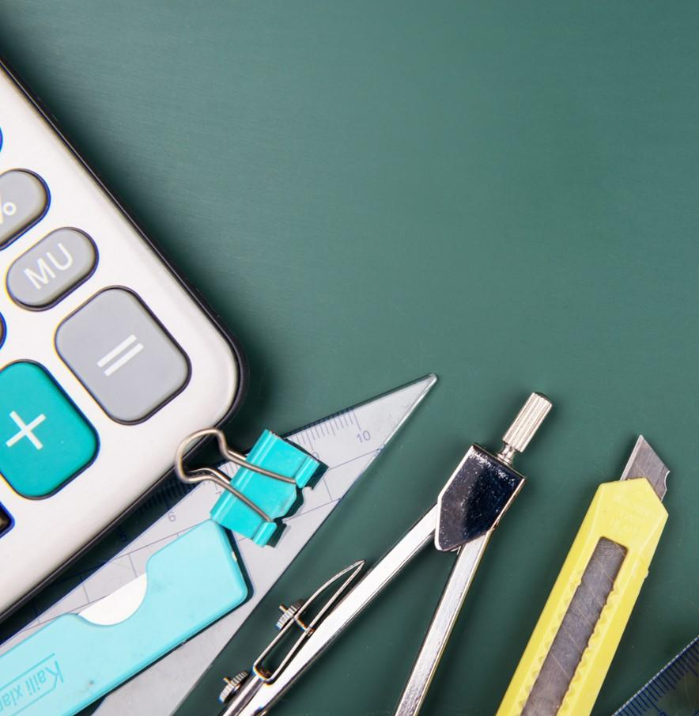
Our Idea and introduction
Our idea is to make an e-school where we are trying to help students with learning almost every subject they have in 9th grade! When starting our program you'll have two options: to Learn or Test yourself!

Slide 5






Apps we used for the project
Teams – Communication Powerpoint – To make the presentation Word – To make the documentation Visual Studio – To make the code Github – Storing our files

Slide 6



Summary
In conclusion we wanted to help 9th graders test their skills with interesting challenging tests for different subjects​, as well as learn subjects faster with our information pages

Slide 7

Thank you
Now we can move to the project

